Slide 1

Algebra 1
Unit 1, Lesson 2 Evaluating Functions in Function Notation Volume 1, pg. 10

Slide 2


Benchmark
MA.912.F.1.2
Given a function represented in function notation, evaluate the function for an input in its domain. For a real-world context, interpret the output.
volume 1, pg. 10

Slide 3
Integrated Mathematical Thinking and Reasoning Standards
MA.K12.MTR.2.1 Demonstrate understanding by representing problems in multiple ways.
MA.K12.MTR.3.1 Complete tasks with mathematical fluency.
MA.K12.MTR.4.1 Engage in discussions that reflect on the mathematical thinking of self and others.
MA.K12.MTR.5.1 Use patterns and structure to help understand and connect mathematical concepts.
volume 1, pg. 10

Slide 4

Learning Target
I can evaluate a function for a specific input value of the domain.
volume 1, pg. 10

Slide 5

Warm-Up
volume 1, pg. 10

Slide 6
1.2.1 Warm-Up: Food and Research Career
Richard works in Research and Development for Kellogg’s. One of the projects he is most proud of involves developing a line of organics products and no added sugar products. Richard also points out that working with a team provides an exciting variety of experiences that is crucial and rewarding to the work of the company.
How could mathematics help in the food science industry?
Why is it important to have teamwork skills when working for a company?
volume 1, pg. 10
Notes:
Video Link: https://algebranation.wistia.com/medias/fi4fidi5y8

Slide 7

Collaboration
volume 1, pg. 11

Slide 8


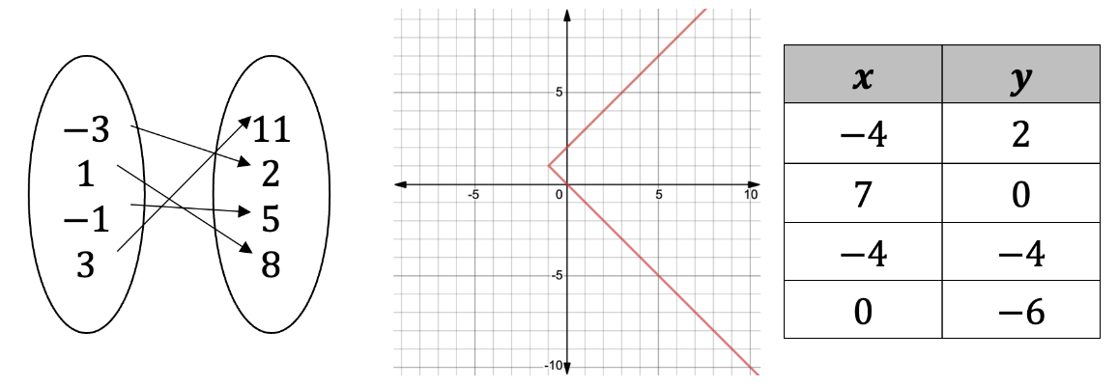
1.2.2 Collaboration: Functions
A relation is a set of input-output pairs.
A function is a mathematical relation for which each element in the domain corresponds to exactly one element in the range.
Three different relations are shown, with each represented in a different way.
volume 1, pg. 11

Slide 9
With your partner, write an explanation identifying which of the relations above are functions.
volume 1, pg. 11

Slide 10

Exploration
volume 1, pg. 11

Slide 11

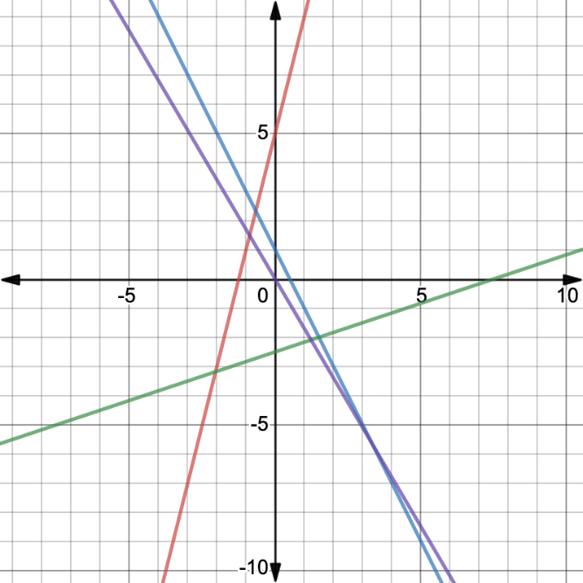
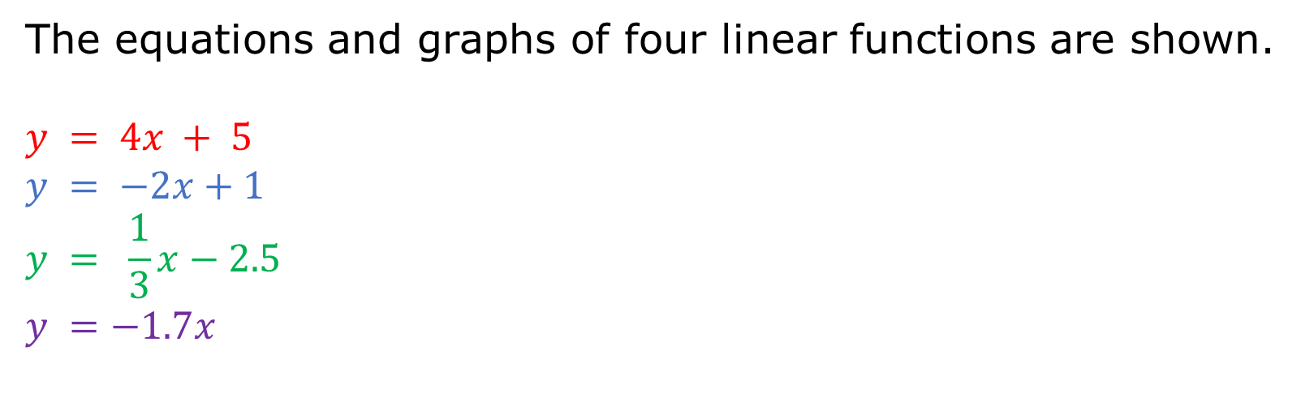
1.2.3 Exploration: Graphs of Functions
The equations and graphs of four linear functions are shown.
$$y = 4x + 5$$
$$y = −2x+1$$
$$y = \frac{1}{3}x−2.5$$
$$y =−1.7x$$
volume 1, pg. 11

Slide 12
Write the equations of the lines that decrease from left to right.
Write the equations of the lines that increase from left to right.
What do the equations of the lines that increase from left to right have in common?
How are the equations of the lines that decrease from left to right different from the equations of the lines that increase from left to right?
volume 1, pg. 11

Slide 13

Guided Instruction
volume 1, pg. 12

Slide 14

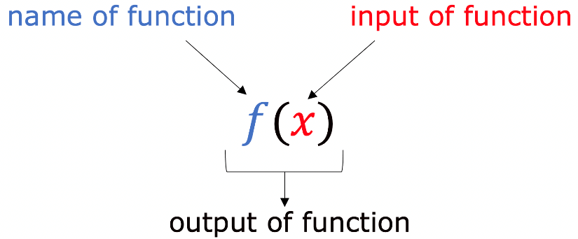
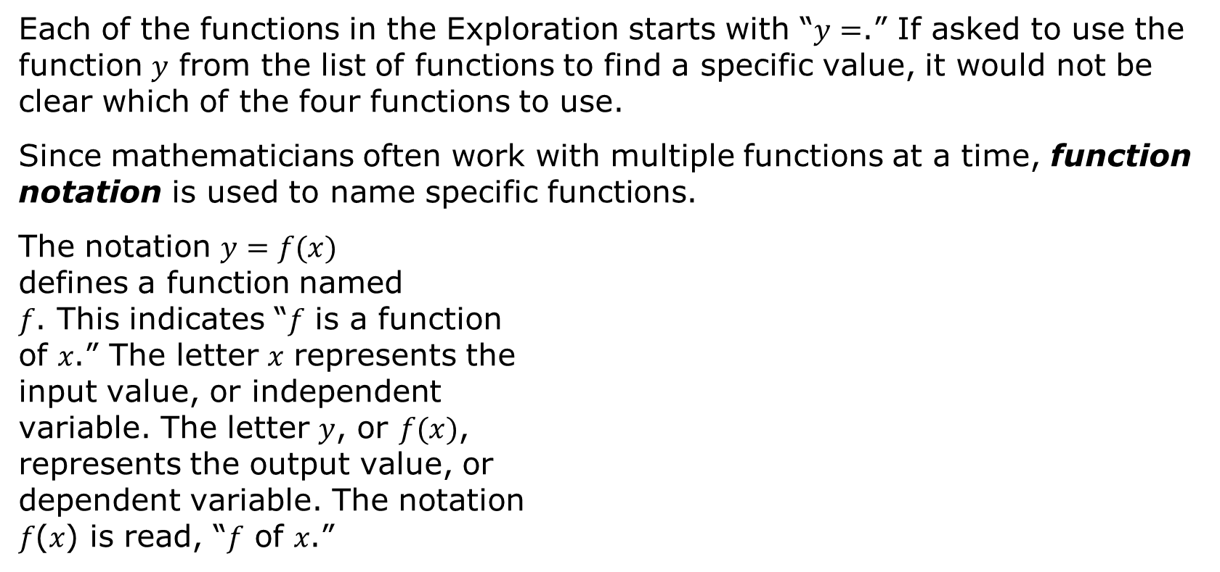
1.2.4 Guided Instruction: Evaluating Functions
Each of the functions in the Exploration starts with “$y=$.” If asked to use the function 𝑦 from the list of functions to find a specific value, it would not be clear which of the four functions to use.
Since mathematicians often work with multiple functions at a time, function notation is used to name specific functions.
The notation $y=f(x)$ defines a function named 𝑓. This indicates “𝑓 is a function of 𝑥.” The letter 𝑥 represents the input value, or independent variable. The letter 𝑦, or $f(x)$, represents the output value, or dependent variable. The notation 𝑓(𝑥) is read, “𝑓 of 𝑥.”
volume 1, pg. 12

Slide 15
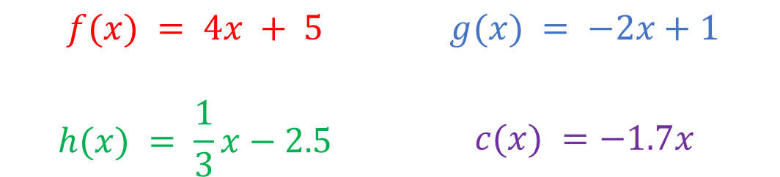
A function can be named using any letter. For example, the previous functions can be renamed as shown:
$$f(x) = 4x + 5$$ | $$g(x) = −2x+1$$
$$h(x) = \frac{1}{3}x−2.5$$ | $$c(x) =−1.7x$$
Now, if asked to use the function ℎ to find a specified value of 𝑥, it would be clear which function to use.
volume 1, pg. 12

Slide 16
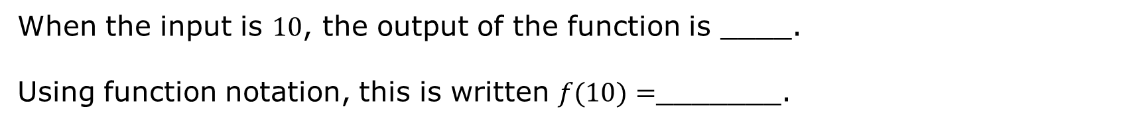
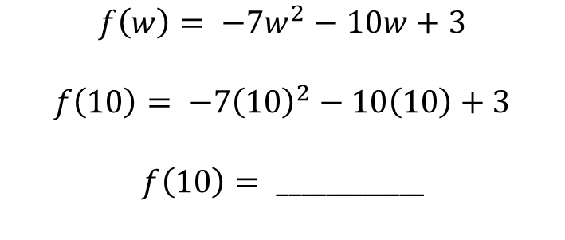
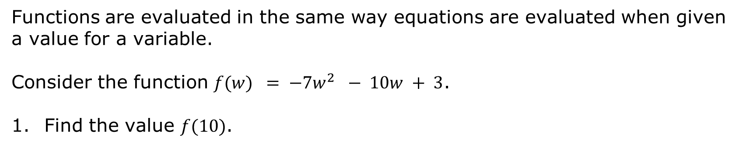
Functions are evaluated in the same way equations are evaluated when given a value for a variable.
Consider the function $f(w) = −7w^{2} − 10w + 3$.
Find the value $f(10)$.
$$f\left(w\right)= −7w^{2}−10w+3$$
$$f\left(10\right)= −7{\left(10\right)}^{2}−10\left(10\right)+3$$
$$f\left(10\right)= ____________$$
When the input is $10$, the output of the function is ____.
Using function notation, this is written $f(10)=$_______.
volume 1, pg. 12

Slide 17
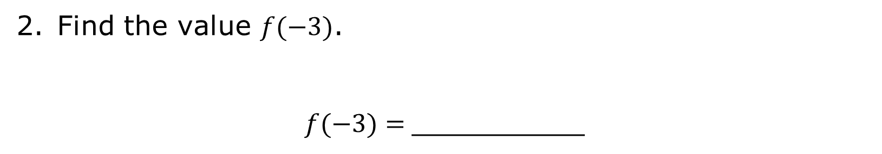
Find the value $f(−3)$.
$f(−3)=$__________
volume 1, pg. 12

Slide 18
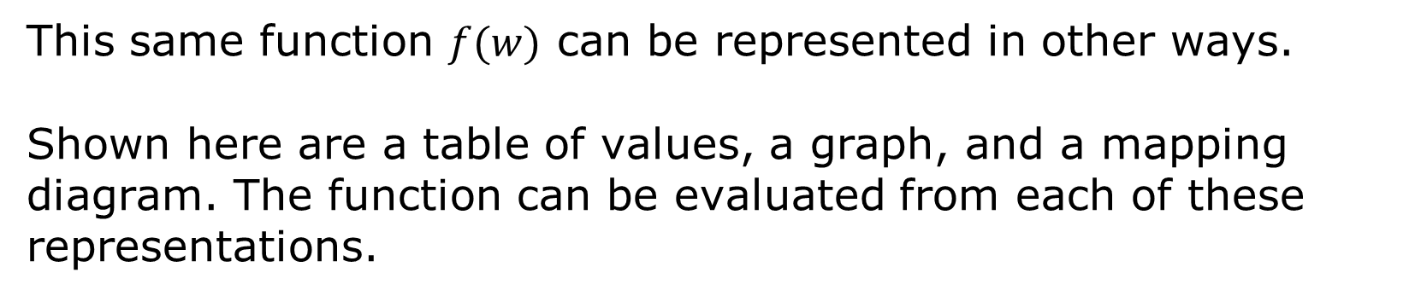
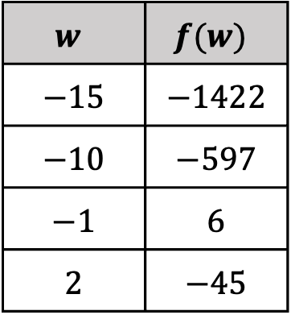
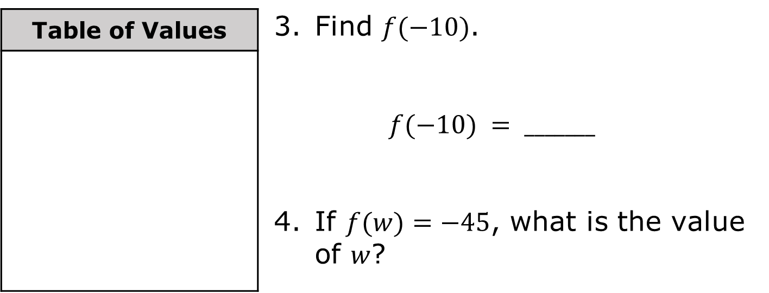
This same function $f(w)$ can be represented in other ways.
Shown here are a table of values, a graph, and a mapping diagram. The function can be evaluated from each of these representations.
Table of Values | Find $f(−10)$. $$f(−10) = _______$$ If $f(w)=−45$, what is the value of $w$?
$$w$$ | $$f(w)$$
$$−15$$ | $$−1422$$
$$−10$$ | $$−597$$
$$−1$$ | $$6$$
$$2$$ | $$−45$$
volume 1, pg. 13

Slide 19
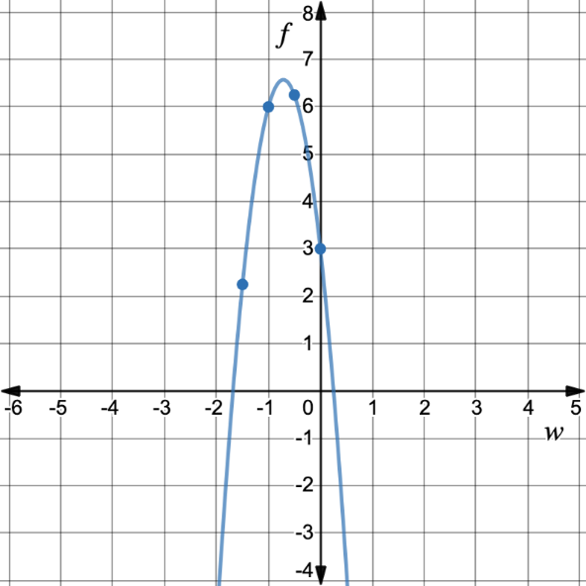




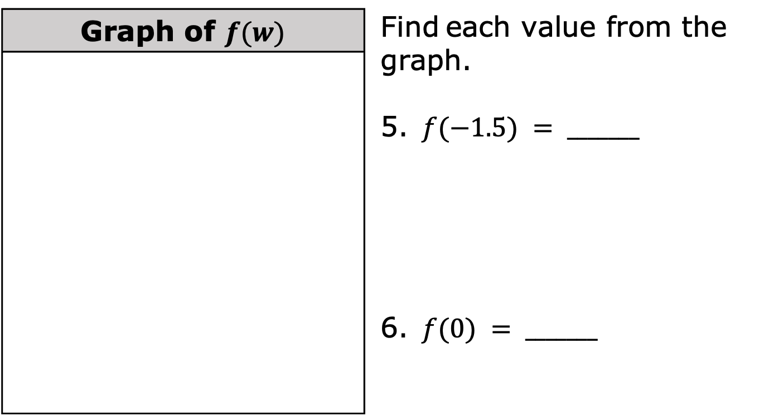

Graph of $f(w)$ | Find each value from the graph. $f(−1.5) = _______$ $f(0) = _______$
$$(−1, 6)$$
$$(−0.5, 6.25)$$
$$(0, 3)$$
$$(−1.5, 2.25)$$
$$(−1.5, 2.25)$$
volume 1, pg. 13

Slide 20
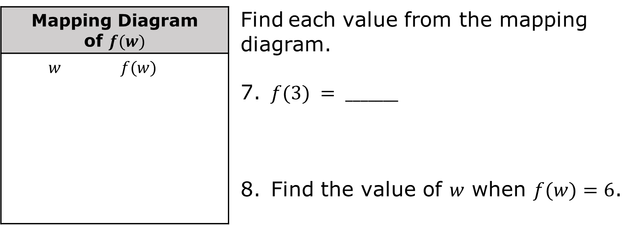


Mapping Diagram of $f(w)$ | Find each value from the mapping diagram. $f(3) = _______$ Find the value of $w$ when $f(w)=6$.
$w$ $f(w)$
$$−10$$
$$−1$$
$$3$$
$$6$$
$$−90$$
$$−597$$
volume 1, pg. 13

Slide 21

Try It
volume 1, pg. 14

Slide 22

1.2.5 Try It: Function Notation
Given the function $c(y)=−6y –5$, find each value.
$c(−4)=$
$c\left(\frac{3}{4}\right)=$
For what value of 𝑦 is $c(y)=9$?
volume 1, pg. 14

Slide 23

Given $g(k)=2k^{2}−4$, find $g(−5)$.
Given $h(x)= \sqrt{2.5x+1}$, find $h(3.2)$.
volume 1, pg. 14

Slide 24
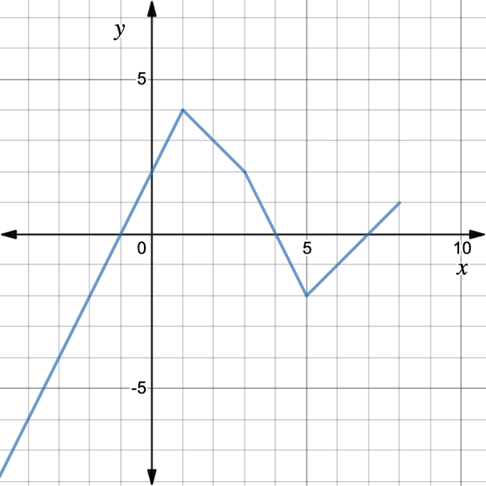
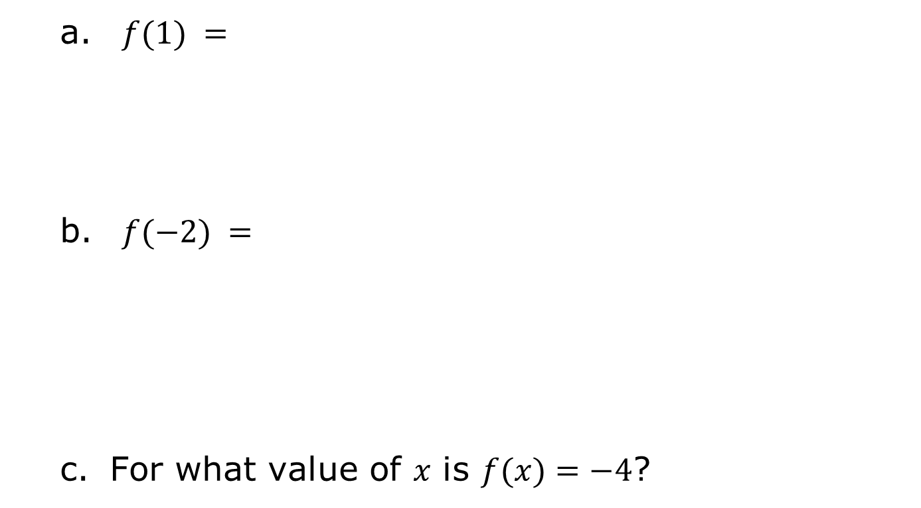
Use the graph of $y=f(x)$ below to find each value.
$f(1) =$
$f(−2) =$
For what value of 𝑥 is $f(x)=−4$?
volume 1, pg. 14

Slide 25

Your Turn
volume 1, pg. 15

Slide 26


1.2.6 Your Turn!
Find each value given the function $m(t) = \frac{t}{3}+ 6$.
$m(−9)=$
Find the input for which $m(t)=13$.
volume 1, pg. 15

Slide 27
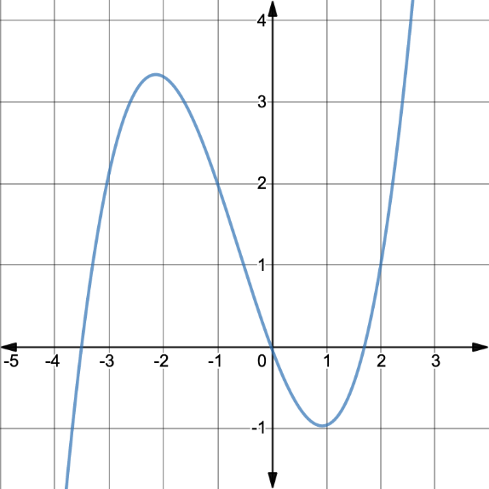
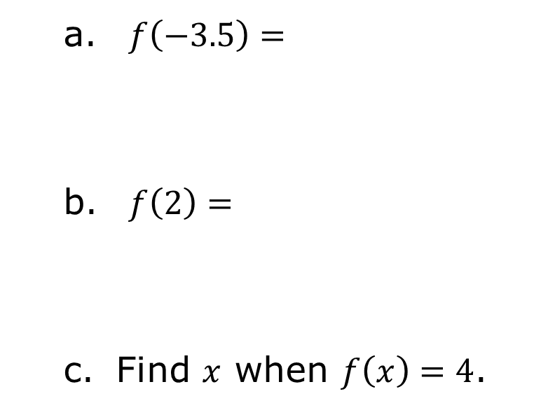
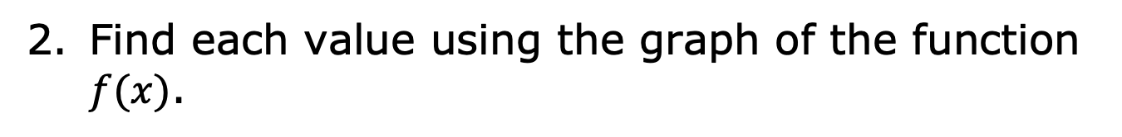
Find each value using the graph of the function $f(x)$.
$f\left(−3.5\right)=$
$f\left(2\right)=$
Find $x$ when $f\left(x\right)=4$.
volume 1, pg. 15

Slide 28
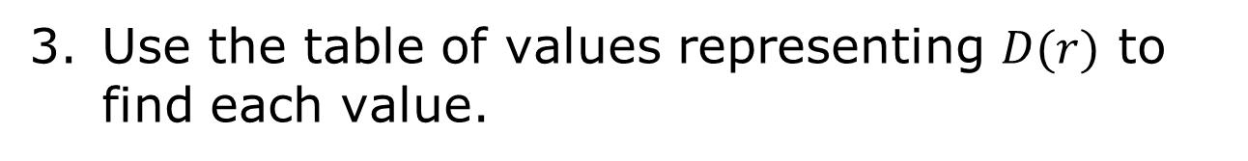
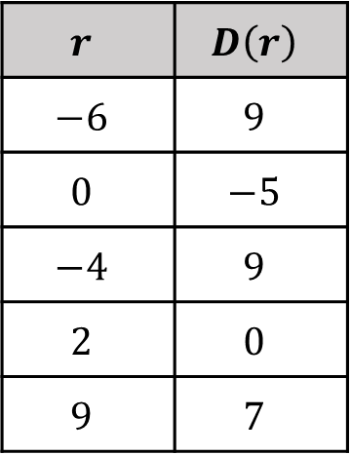
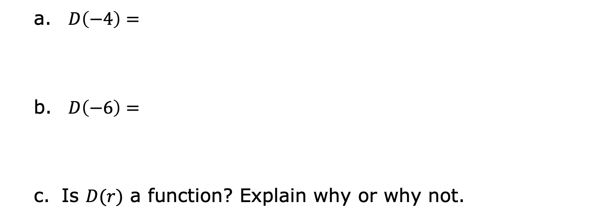
Use the table of values representing $D(r)$ to find each value.
$$r$$ | $$D\left(r\right)$$
$$−6$$ | $$9$$
$$0$$ | $$−5$$
$$−4$$ | $$9$$
$$2$$ | $$0$$
$$9$$ | $$7$$
$D\left(−4\right)=$
$D\left(−6\right)=$
Is $D(r)$ a function? Explain why or why not.
volume 1, pg. 15

Slide 29

Wrap-Up
volume 1, pg. 15

Slide 30
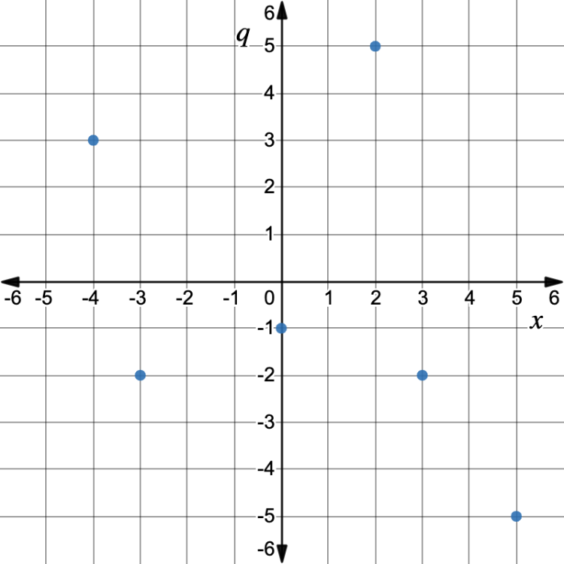
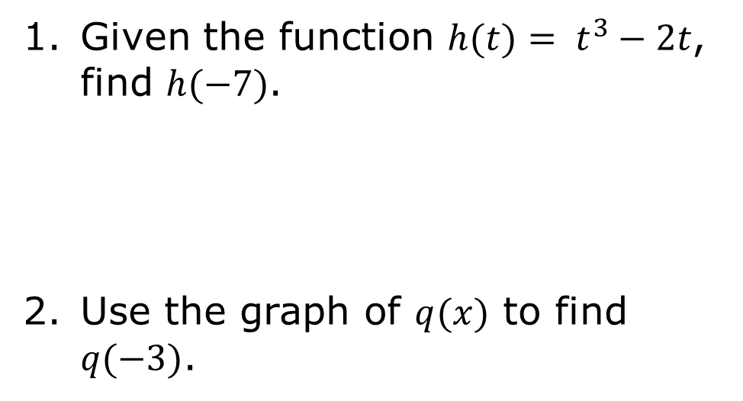
1.2.7 Wrap-Up: Ticket Out the Door
Given the function $h(t)= t^{3}−2t$, find $h(−7)$.
Use the graph of $q(x)$ to find $q(−3)$.
volume 1, pg. 15

